Slide 1

Department of Telecommunication Engineering
Jawaharlal Nehru National College of Engineering, Shivamogga
PROJECT SEMINAR ON,
“RPI BASED HOME SECURITY
WITH FACE RECOGNITION”
Presented by,
Lavisha.K.L 4JN14TE020
Rohith.S 4JN14TE033
Sindhuja.D.S 4JN14TE406
Vijayalakshmi.N 4JN14TE411
Under the guidance of,
Prof.Benak Patel .M.P. _{B.E,M.E,}
Dept. of TCE

Slide 2
CONTENTS
Introduction
Objective of our project
Block diagram
Functional block diagram
System layout
Circuit diagram
Flowchart
Working principle
Hardware components
Software components
Output
Advantages
Application
Future scope
Reference

Slide 3
INTRODUCTION:-
The world is changing dynamically .
Modernization may lead to increase in crime.
Insurance companies.
Consumer demand.

Slide 4
Home owners.
Ensure that doors are locked.
Main objective.
Automated security system -surveillance and security.
CONTD..

Slide 5
OBJECTIVES:-
To design a home security system.
To implement real time, face recognition.
Obtain a wireless alert system for the house.
Obtain an exclusive secure access using RFID.

Slide 6
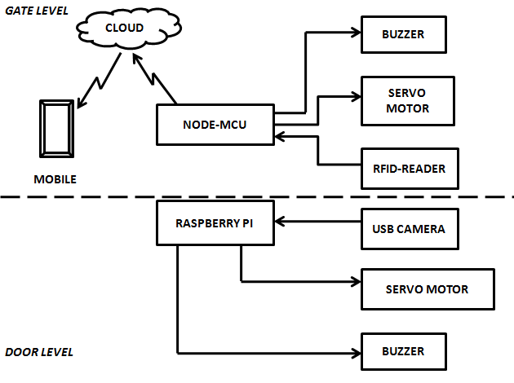
BLOCK DIAGRAM:-

Slide 7
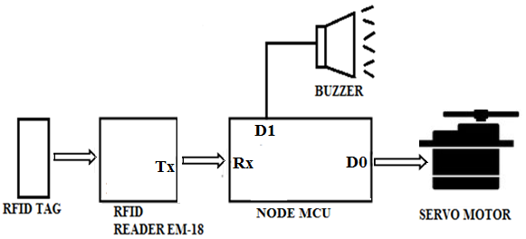
FUNCTIONAL BLOCK DIAGRAM:-
At gate level:-

Slide 8
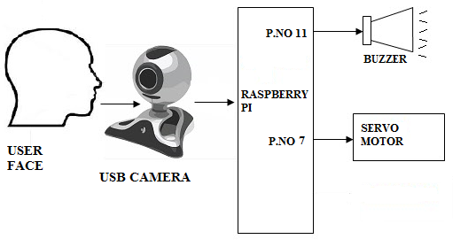
ii. At door level:-

Slide 9
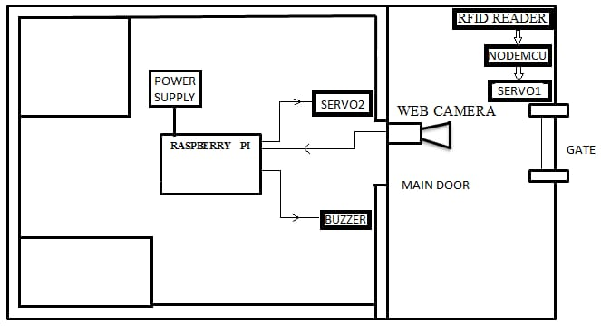
SYSTEM LAYOUT:-

Slide 10
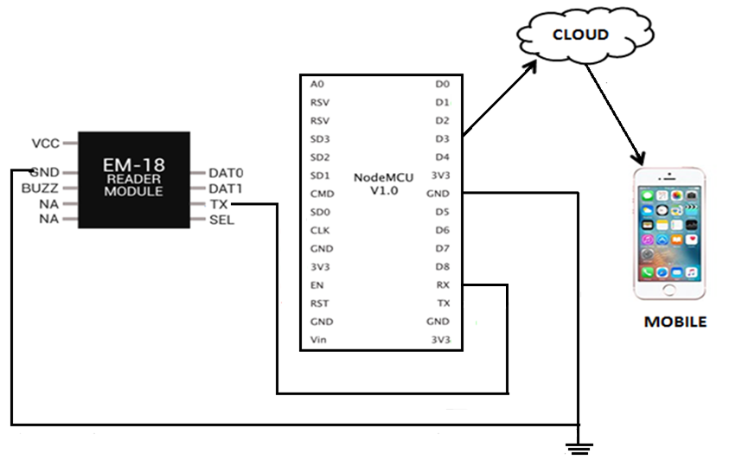
CIRCUIT DIAGRAM:-

Slide 11
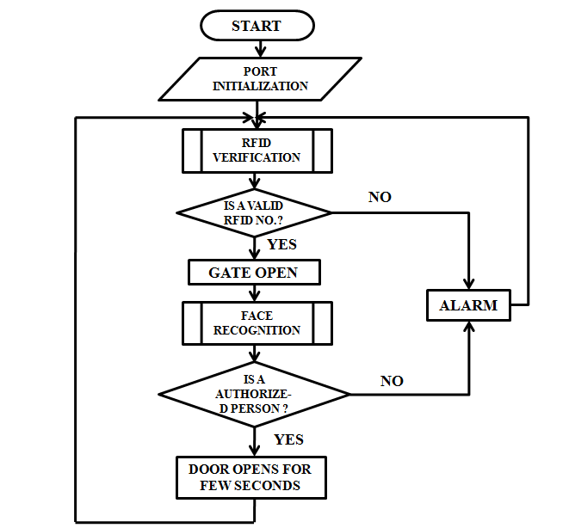
FLOW CHART:-

Slide 12
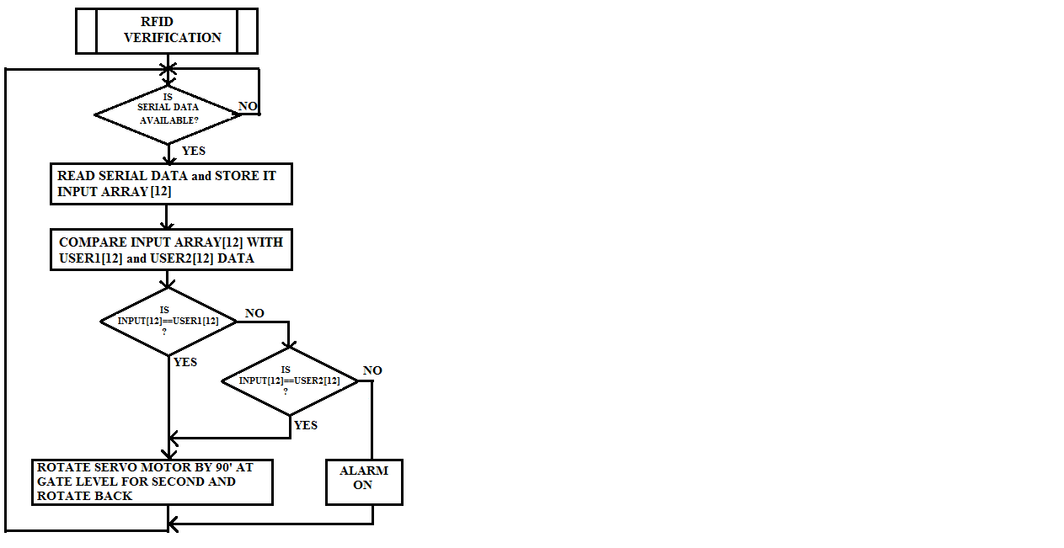
Flow chart Level-1 security

Slide 13
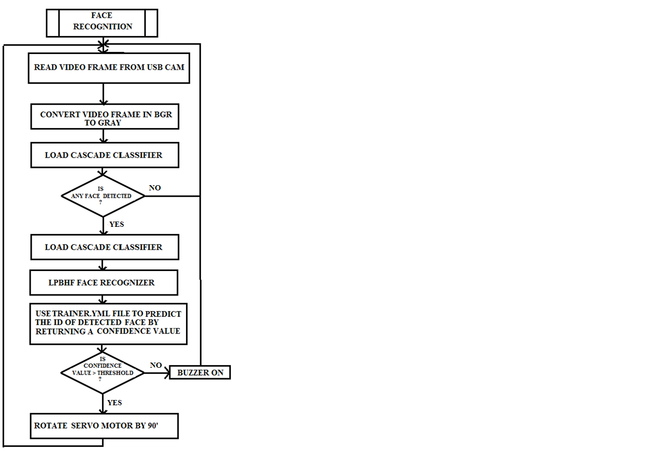
Flow chart Level-2 security

Slide 14
WORKING PRINCIPLE:-
Port initialisation.
RFID initialisation.
Verification of RFID number.
Door unlock.
Face recognition
PCA method.
Classification using confidence measure.
Verification of person.

Slide 15
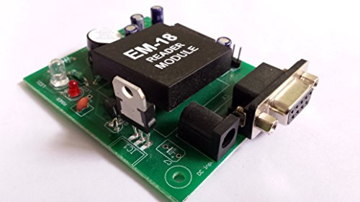
Hardware components:-
1.RFID READER EM-18
It can read 125KHz tags.
Low frequency RFID reader.
Serial output and has a range of
about 8-12cm.
Built-in antenna.
Specifications
Current: <50mA
Operating Frequency: 125 KHz
Read Distance: 10cm

Slide 16
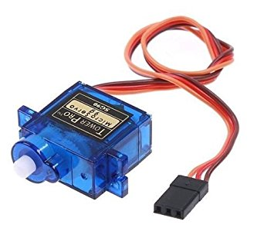
2.SERVO MOTOR
Rotary actuator or Linear actuator.
It consists of 3 parts
Controller device.
Output sensor.
Feedback system.

Slide 17
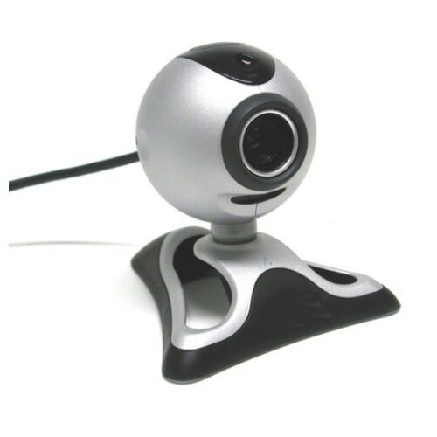
3.USB CAMERA
Uses USB 2.0 or USB 3.0 technology to transfer image data.
Easily interface with dedicated computer systems.
USB Cameras ideal for many imaging applications.
Data transfer rates of up to 5 Gb/s.

Slide 18
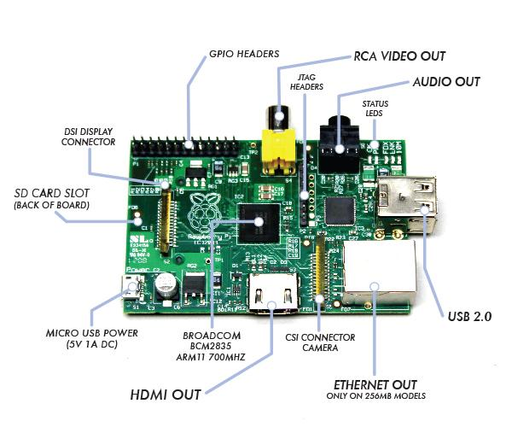
4.RASPBERRY PI
Low cost, credit-card
sized computer.
Capable of doing everything,
Browsing the internet
and playing a high-definition
video.
To making spreadsheets.
Word-processing.
Playing games.

Slide 19
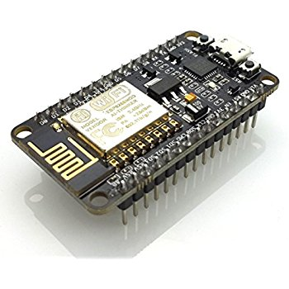
5.NODE MCU
Open source firmware.
Arduino IDE or in few Lau script lines.
Runs on the ESP8266 Wi-Fi SoC.
Hardware which is based on the ESP-12 module.

Slide 20
Software requirements:-
Raspbian Jessie.
Python IDE.
OPEN CV 2.3.1
C,C++

Slide 21
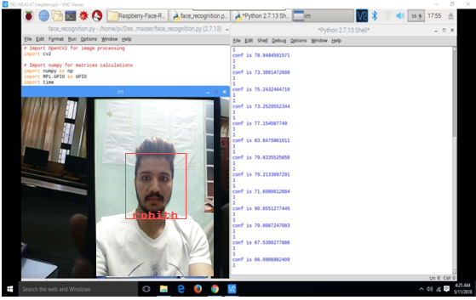
OUTPUT:-

Slide 22
ADVANTAGES
Protect valuables.
Deters crime.
Lowers Homeowner’s Insurance.
Makes Room for peace of mind.

Slide 23
Applications:-
Residential complex/societies are secured using home security system that helps to keep a control/check of any potential intrusion.
Commercial campuses installed with security system will have an advantage to avoid any valuable or management losses.
Military properties provided with security system prevent any unauthorized intrusion or loss of documents.

Slide 24
FUTURE SCOPE:-
3D facial recognition.
More reliable.
Video processing.
Android app.

Slide 25
References:-
[1] Rajesh Kannan Megalingam, Ramesh Nammily Nair, Sai Manoj Prakhya and Mithun Mohan, “Low Power, Intelligent, Wireless, Home Security System for the Elderly People”,2011 IEEE.
[2] Ma. Christina D. Fernandez, Kristina Joyce E. Gob, Aubrey Rose M. Leonidas,Ron Jason J. Ravara, Argel A. Bandala and Elmer P. Dadios, “Simultaneous Face Detection and Recognition using Viola-Jones Algorithm and Artificial Neural Networks for Identity Verification”, IEEE Region 10 Symposium, 2014.

Slide 26
[3] Mrutyunjaya Sahani, Susanta Kumar Rout, Atul Kumar Sharan, and Subbradeep Dutta, “Real Time Colour Image Enhancement with a high regard for restoration of skin colour by using Raspberry Pi”, 2014 IEEE.
[4] Mrutyunjaya Sahani, Chiranjiv Nanda, Abhijeet Kumar Sahu and Biswajeet Pattnaik, “Web-Based Online Embedded Door Access Control and Home Security System Based on Face Recognition”, International Conference on Circuit, Power and Computing Technologies [ICCPCT].

Slide 27
THANK YOU

